Slide 1
This Week
Homework: Reading\Writing to files
Project 1
Cursors!

Slide 2
Arcpy Cursors
Gregory Brunner

Slide 3
Cursors
Provide row-by-row access to feature data
3 Types
Search Cursor – Read only access to rows
Update Cursor – Update and delete rows
Insert Cursor – Insert new rows into a feature class
Used through the arcpy data access module (arcpy.da)

Slide 4
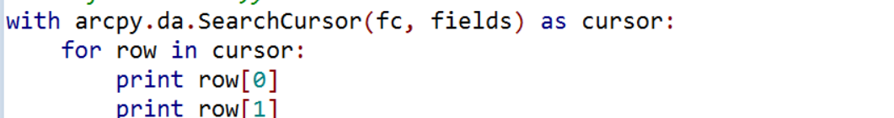
Implementation
arcpy.da cursors opened using “with” statements
“With” denotes when feature class is opened
Row values accessed by index

Slide 5
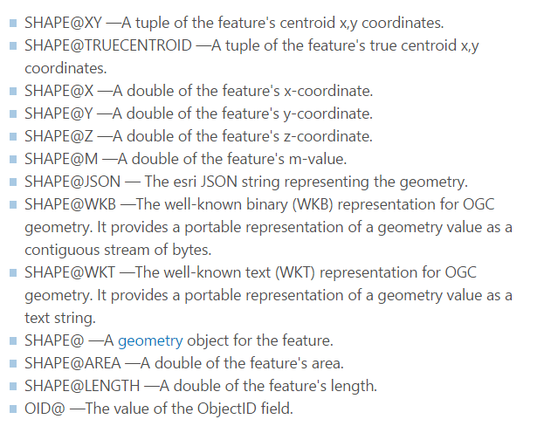
Fields and Tokens
Define only the fields in the Feature class you are interested in
Tokens give easy access to geometries and object ID

Slide 6
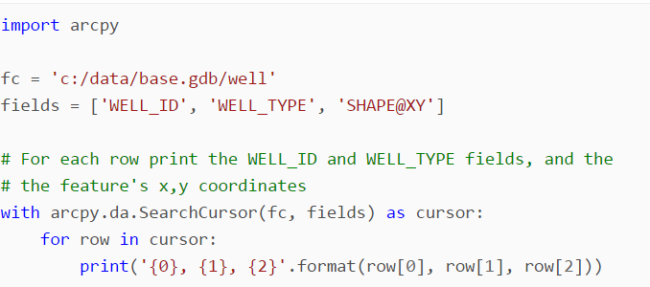
Search Cursor
http://desktop.arcgis.com/en/arcmap/10.3/analyze/arcpy-data-access/searchcursor-class.htm

Slide 7
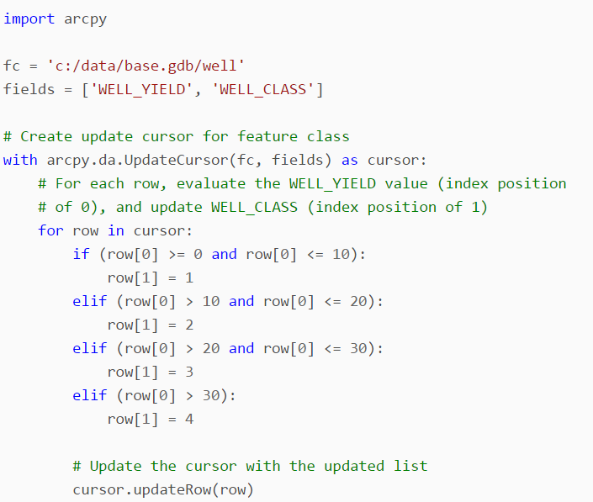
Update Cursor
http://desktop.arcgis.com/en/arcmap/10.3/analyze/arcpy-data-access/updatecursor-class.htm

Slide 8
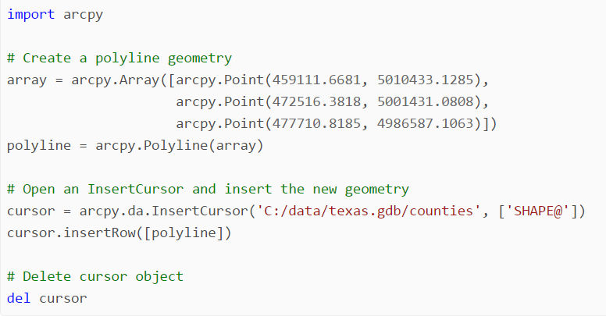
Insert Cursor
http://desktop.arcgis.com/en/arcmap/10.3/analyze/arcpy-data-access/insertcursor-class.htm

Slide 9
Examples
Gregory Brunner

Slide 10
Next Week (Week 6)
We will cover Geometries.
Project 1 is posted and is due on February 25
Proposal for your Final Project is due in 3 weeks
Submit

